Slide 1
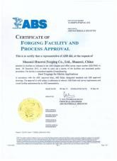
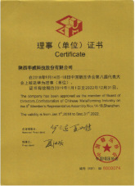
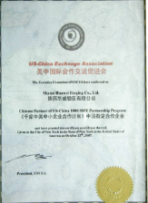
质量证书 Certifications
美国船级社（ABS）认证证书
ABS certification
阿里巴巴与法国船级社（BV、TUV）认证证书
BV & TUV certification
中国锻压协会（CCMI）理事单位证书
Confederation of Chinese Metal-forming Industry certificate
千家中美企业合作单位证书
Certification of US-China Exchange Association

Slide 2
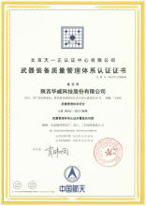
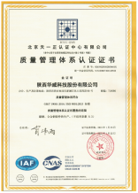
质量证书 Certifications
武器装备质量管理体系认证证书
Certification of the quality management system of weaponry
ISO14001:2015环境管理体系认证证书
ISO14001:2015 certificate
ISO45001:2018职业健康安全体系认证证书
ISO45001:2018 certificate
ISO9001:2015质量管理体系认证证书
ISO9001:2015 certificate

Slide 3
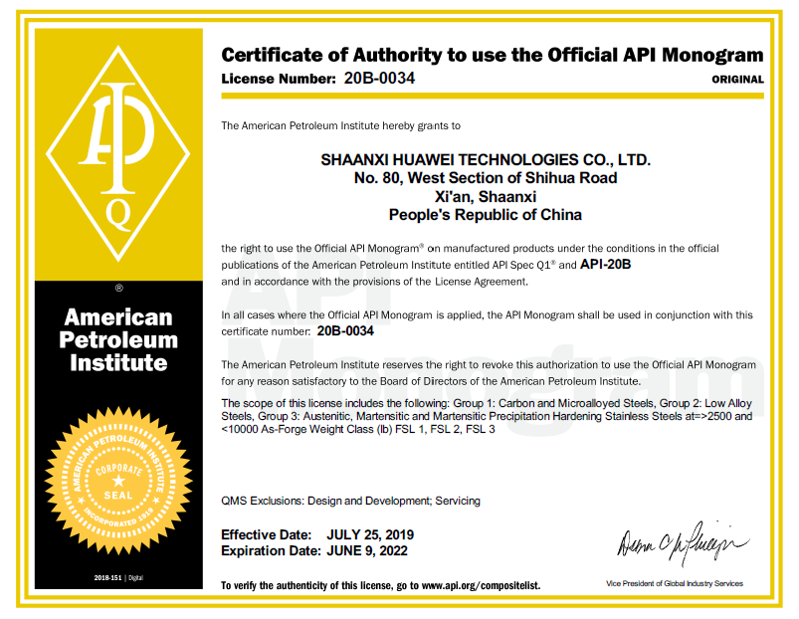

质量证书 Certifications
美国石油协会认证证书
API certificate

Slide 4
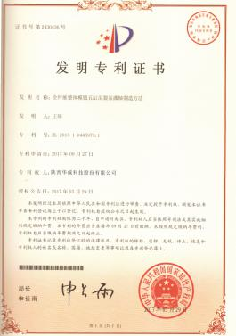
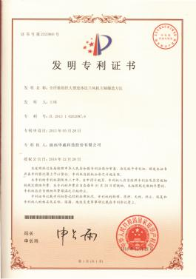
专利证书 Certificates of Patents
全纤维整体模锻五缸压裂泵曲轴制造方法
Forging method of five-cylinders fracturing pump crankshaft with full fiber structure
专利号/Patent No.: 2013092700536200
全纤维组织大型连体法兰风机主轴锻造方法
Forging method of large flanged wind turbine main shaft with full fiber structure
专利号/Patent No.: 2013052800614540

Slide 5
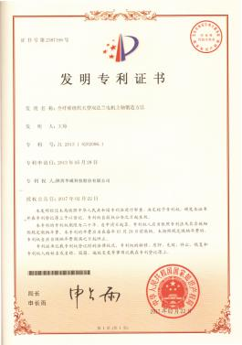
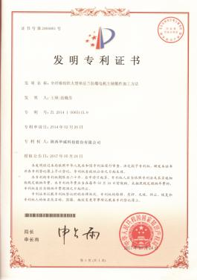
专利证书 Certificates of Patents
全纤维组织大型双法兰电机主轴锻造方法
Forging method of large double-flanged motor shaft with full fiber structure
专利号/Patent No.: 2013052800614490
全纤维组织大型单法兰防爆电机主轴锻件锻造加工方法
Forging method of large single-flanged explosion-proof motor shaft with full fiber structure
专利号/Patent No.: 2014022600536220

Slide 6
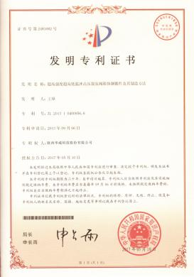
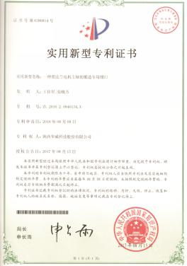
专利证书 Certificates of Patents
高压高强度高低温冲击压裂泵阀箱钢锻件及其制造方法
Forging method of steel fracturing pump valve box under high pressure, high intensity and ultra-low temperature
专利号/Patent No.: 2013090600435210
一种带法兰电机主轴的锻造专用钳口
Utility Model Patent--Special jaw for forging flanged motor spindles

Slide 7
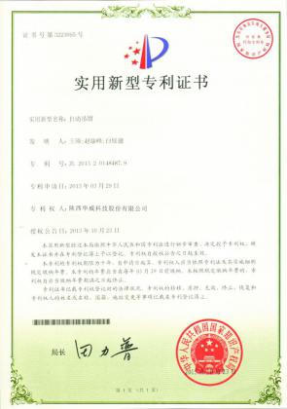
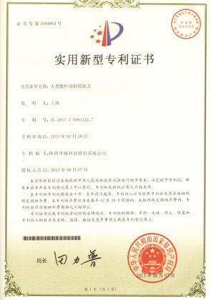
专利证书 Certificates of Patents
自动吊钳
Automatic tongs
大型锻件切割用剁刀
Cutting tools for cutting large forgings

Slide 8
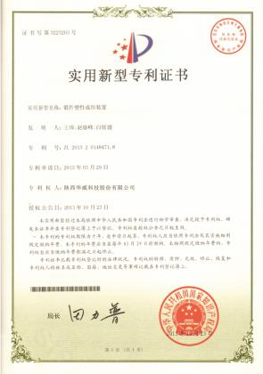
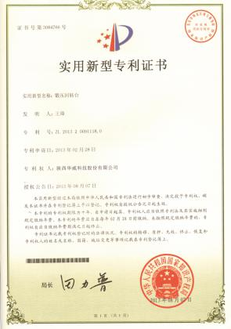
专利证书 Certificates of Patents
锻件塑性成形装置
Equipment for metal forming of forgings
锻压回转台
Forging rotary platform

Slide 9
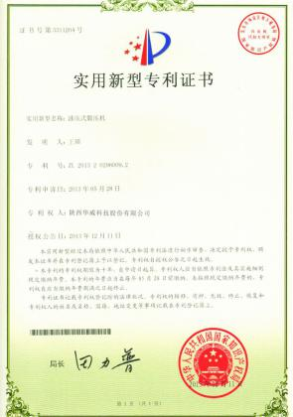
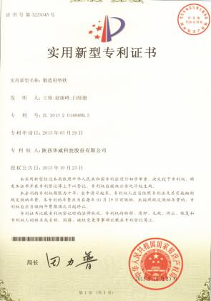
专利证书 Certificates of Patents
油压式锻压机
Hydraulic forging machines
锻造用垫铁
Iron Pad for forging

Slide 10
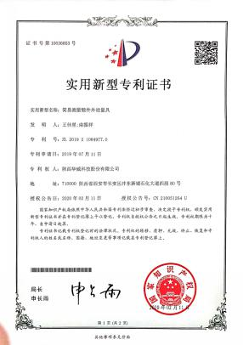
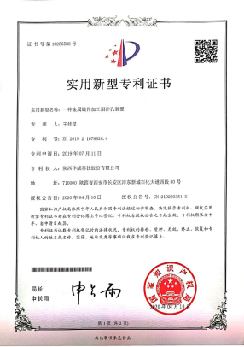
专利证书 Certificates of Patents
简易测量锻件外径量具
Simple tool for measuring outside diameter of forgings
金属锻件冲孔装置
Piercing device for metal forgings

Slide 11
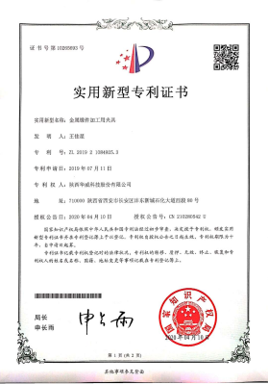
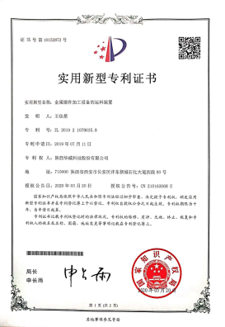
专利证书 Certificates of Patents
金属锻件加工用夹具
Clamps for metal forging
锻件加工设备运料装置
Forging equipment material handling equipment

Slide 12
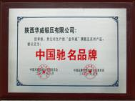
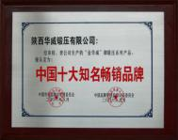

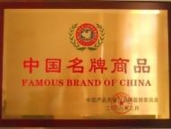


社会荣誉 Honors
中国驰名品牌
China well-known brand
中国十大知名畅销品牌
Top 10 well-known and best-selling brand of China
中国锻造产业五十强企业
Top 50 enterprises of China forging industry
中国名牌商品
The famous brand in China province
国家AAA级重质量守信用企业
The national AAA class quality-focused and credit-kept enterprise
中国轧辊制造业十强企业
Top 10 enterprises of Chinese roller manufacturing industry

Slide 13

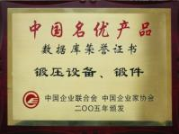

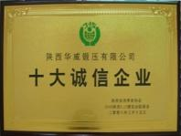
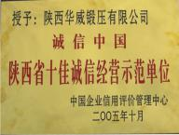
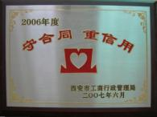
社会荣誉 Honors
中国优秀企业
Chinese outstanding enterprises
中国名优产品
Chinese famous quality products
陕西制造行业十大品牌
Top Ten Brands in Shaanxi Manufacturing Industry
陕西省十大诚信企业
Top ten credit enterprise in shaanxi province
陕西省十佳诚信经营示范单位
Shaanxi top ten good faith management demonstration unit
西安市守合同重信用企业
Contract-honored and credit-kept enterprise of Xi'an

Slide 14
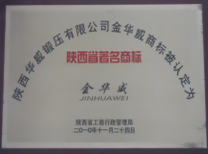
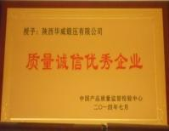
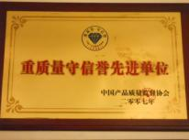

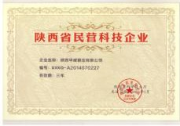
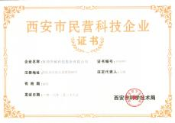
社会荣誉 Honors
陕西省著名商标
Shaanxi Famous Trademark
中国质量诚信优秀企业
Quality and integrity outstanding enterprise of China
重质量守信誉先进单位
Advanced quality-focused and credit-kept enterprise
陕西省企业家协会常务理事单位
Shaanxi Private Technology
陕西省民营科技企业
Shaanxi Private Technology Enterprise
西安市民营科技企业
Xi’an Private Technology Enterprise

Slide 15

社会荣誉 Honors
西安市金属材料成型工程技术研究中心Xi'an Metal Forming Engineering Research Centre
高新技术企业
High-tech enterprise
2019年先进制造业标准化试点单位Advanced manufacturing standardization pilot units in 2019
A 级纳税人Class A taxpayer

Slide 16
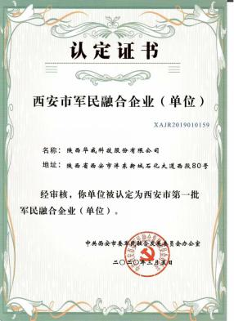
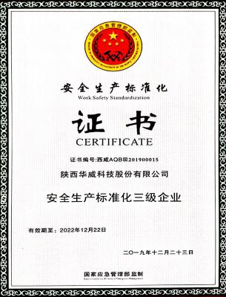
社会荣誉 Honors
西安市第一批军民融合企业（单位）The first civil-military fusion enterprises in Xi'an
安全生产标准化三级企业
Three-level enterprise of safety production standardization

Slide 17
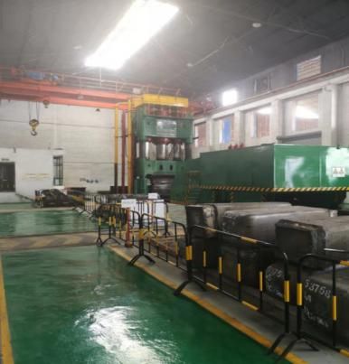
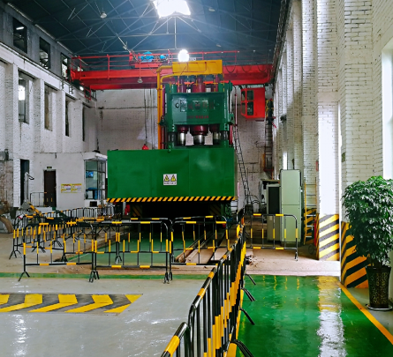
锻造车间 Forging workshop
3500吨自由锻液压机
3,500 tons free forging hydraulic press

Slide 18
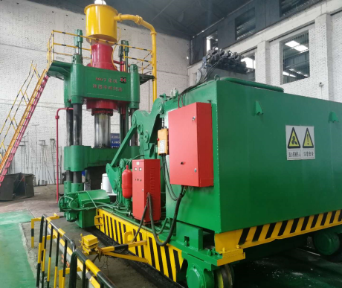
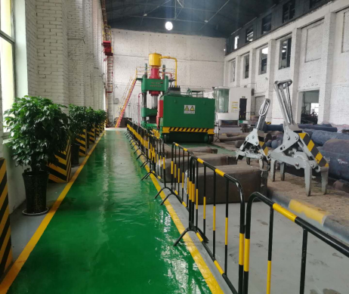
锻造车间 Forging workshop
800吨自由锻液压机
800 tons free forging hydraulic press

Slide 19
锻造车间 Forging workshop
2吨电液锤
2 t of electro-hydraulic hammer
560kg空气锤
560kg air hammer

Slide 20
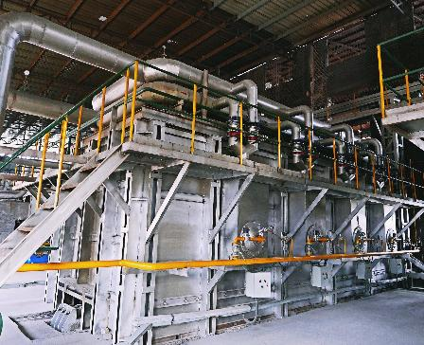
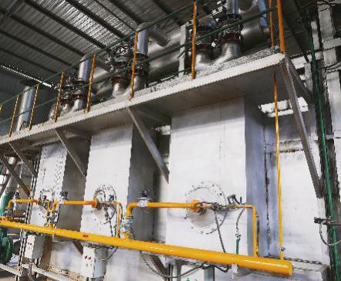
锻造加热设备 Heating furnaces workshop
我们拥有4组燃气加热炉，其中2台为蓄热式燃气加热炉
We have 4 sets of gas heating furnaces, including 2 sets of Regenerative gas furnaces

Slide 21
热处理车间 Heat treatment equipment
8米转子实验炉
8m Rotor test furnace
2米气体渗碳炉
2m Gas Carburizing furnace

Slide 22
热处理车间 Heat treatment equipment
6米台车式热处理炉
6m Trolley type heat treatment furnace
4米台车式热处理炉
4m Trolley type heat treatment furnace

Slide 23
热处理车间 Heat treatment equipment
3米大口径井式炉
3m Large diameter well furnace
9米井式炉
9m Pit furnace

Slide 24
热处理车间 Heat treatment equipment
6米台车式热处理炉
6m Trolley type heat treatment furnace
淬火槽系统
Quenching tank system

Slide 25
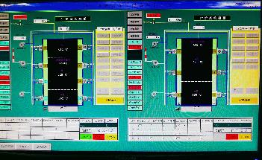
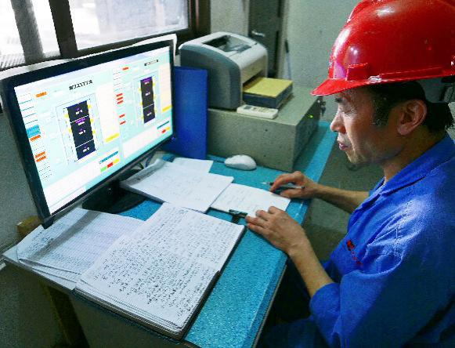
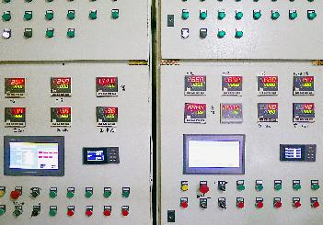
加热热处理车间 CNC heating equipment

Slide 26
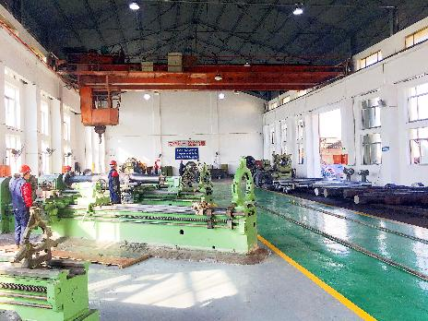
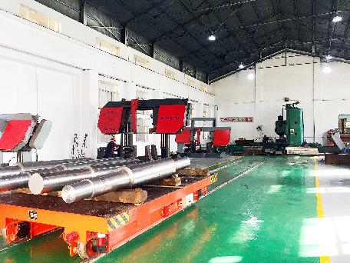
机加工车间 Machining workshop

Slide 27
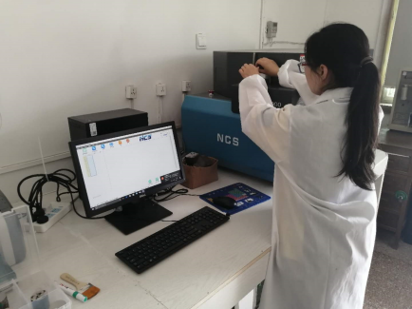
理化检验中心 Physical and chemical test center
化学成份分析实验室
Chemical Composition Analysis Laboratory

Slide 28
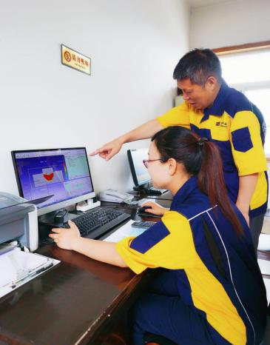
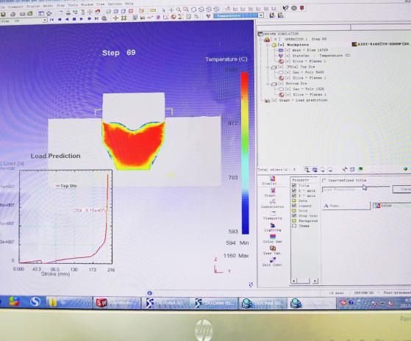
技术团队 Engineering team

Slide 29



核心产品 CORE PRODUCTS
200MN模锻液压机上垫板
Upper pad of 200MN Die forging hydraulic pres

Slide 30


核心产品 CORE PRODUCTS
导弹吊架
Missile hanger

Slide 31



核心产品 CORE PRODUCTS
模具模块1
Module for mold 1

Slide 32


核心产品 CORE PRODUCTS
模具模块2
Module for mold 2

Slide 33



核心产品 CORE PRODUCTS
压裂泵阀箱
Valve box for fracturing pump

Slide 34

核心产品 CORE PRODUCTS
在内部
inside
压裂泵曲轴
Crankshaft for fracturing pump

Slide 35



核心产品 Core Products
防喷器锻件
Blow-out Preventer (BOP)

Slide 36

核心产品 Core Products
双法兰防爆电机主轴
Double-flange Explosion-Proof Motor spindle

Slide 37
核心产品 Core Products
单法兰防爆电机主轴
Single-flange Explosion-Proof Motor spindle

Slide 38


核心产品 CORE PRODUCTS
风电主轴
Wind power main shaft

Slide 39


核心产品 CORE PRODUCTS
中间大齿轮
Large Intermediate Gear

Slide 40


核心产品 CORE PRODUCTS
10000kg高速齿轮轴
10000kg High Speed Gear

Slide 41


核心产品 CORE PRODUCTS
轧辊
Mill Rolls 1

Slide 42



核心产品 CORE PRODUCTS
电机轴 Motor Shafts

Slide 43



核心产品 CORE PRODUCTS
汽缸体
Cylinder body

Slide 44



核心产品 CORE PRODUCTS
压力容器
Pressure vessel

Slide 45



核心产品 CORE PRODUCTS
Gear Rings
齿圈

Slide 46


核心产品 CORE PRODUCTS
法兰
Flange

Slide 47



核心产品 CORE PRODUCTS
Parts for Marine Propulsion Equipment
船用推进设备用部件
长中间轴
Long intermediate shaft

Slide 48


核心产品 CORE PRODUCTS
5吨电气锤锤头
5tons hammer head for Electric hammer

Slide 49


核心产品 CORE PRODUCTS
碳钢法兰
Carbon Steel Flange

Slide 50


核心产品 CORE PRODUCTS
冷轧辊
Cold Mill Roll

Slide 51


















主要客户 Main customers

Slide 52








主要客户 Main customers

Slide 53














主要客户 Main customers

Slide 54

业务市场 Main Market

